Slide 1
COUPON RECOMMENDATION PREDICTIONS
Background information about the stakeholder and their problem
Business Owners: The business owners who provide the in-vehicle coupon recommendation would be interested in the success of the model as it would help them to understand which coupons are most likely to be accepted by drivers. This can help them to optimize their marketing strategies and increase their sales.
Drivers: The drivers who receive the coupon recommendations would benefit from the model as it would provide them with personalized recommendations based on their preferences. This can help them to save money on products or services they are interested in.

Slide 2
Conti……
Data Analysts: The data analysts who build and maintain the model would benefit from it as it provides a valuable tool for understanding customer behaviour and optimizing marketing campaigns. The model helps them to identify which features are most important in predicting coupon acceptance and to make data-driven decisions.
Regulators: Regulators interested in promoting fair and ethical practices in marketing could benefit from the model as it helps to ensure that coupon recommendations are being made in a non-discriminatory way, and are not biased based on factors such as gender, race, or location.

Slide 3
Background information about the stakeholder and their problem
In summary:-
The problem that the model solves for each stakeholder is different. For example, for business owners, it helps them to optimize their marketing strategies and increase sales. For drivers, it provides personalized recommendations that can help them save money. For data analysts, it provides a tool for understanding customer behaviour and making data-driven decisions. And for regulators, it helps to ensure fair and ethical marketing practices.

Slide 4
Background info a the data
This data studies whether or not a driver will accept the coupon recommended to him in different driving scenarios. The, different driving scenarios include the destination of the driver, current time of the drive, the weather, whether the driver has a passenger with them or not, etc., and then the person is asked whether or not they will accept the coupon.

Slide 5
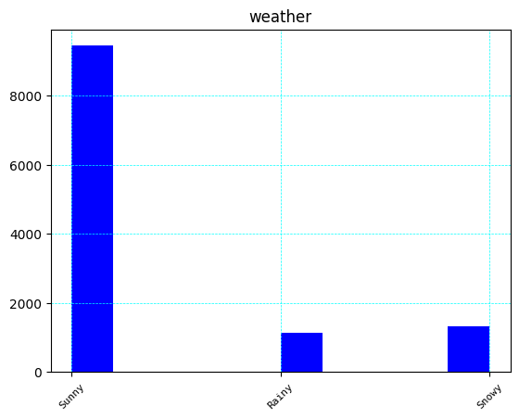
Visualizations
From the above graph , Most drivers are available and participate in receiving coupons during sunny whether compared to rainy and snowy weather

Slide 6
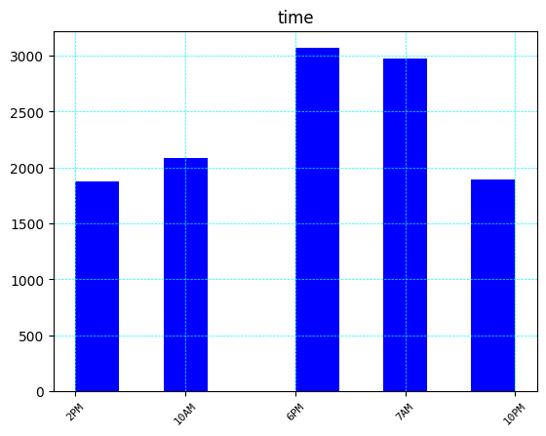
From the graph below, drivers tend to accept coupons during the time of 6pm and 7 am

Slide 7
A brief description of the strengths and limitations of your model for your stakeholder.
Random Forest Classifier is a powerful and flexible algorithm that can handle a wide range of classification tasks
Accurate: Random Forest is known for its high accuracy in predicting outcomes. It is a robust model that can handle complex and nonlinear relationships in the data. This makes it suitable for predicting whether or not a driver will accept to take in-vehicle coupon recommendations, as there may be many factors that influence their decision.
Robust to Overfitting: Random Forest is less likely to overfit than other models, as it creates multiple decision trees and averages their predictions. This helps to reduce the variance of the model and increase its accuracy.

Slide 8
Feature Importance: Random Forest provides a measure of feature importance, which can help in understanding which variables are most important in predicting the outcome. This can be useful in identifying the factors that influence a driver's decision to accept or reject in-vehicle coupon recommendations.

Slide 9
Limitations of the model to the stakeholders
Overfitting: The can suffer from overfitting especially if the number of trees in the forest is too high or if the data used to train the model is too complex or noisy. Overfitting occurs when the model learns the training data too well and cannot generalize to new data. Interpretability: This model is a bit a complex algorithm, and it can be difficult to interpret the results. It can be hard to understand how the model arrived at a particular prediction, which can be a challenge for some applications.
Feature Importance: This model may not accurately rank the importance of features if there are strong correlations between the features. In such cases, the model may give a high importance score to one feature and a low score to another feature, even if they are highly correlated. This can make it difficult to understand the true importance of each feature.

Slide 10
Computationally Expensive: Random Forest Classifier can be computationally expensive, particularly when there are many features or a large number of trees in the forest. This can make training and prediction time-consuming.
Interpretability: Random Forest Classifier is a complex algorithm, and it can be difficult to interpret the results. It can be hard to understand how the model arrived at a particular prediction, which can be a challenge for some applications.

Slide 11
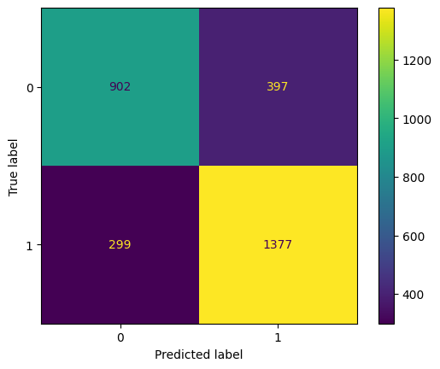
Models confusion matrix

Slide 12
Explaining how the model's false positive and false negative rates will affect your stakeholder. Be sure to consider class balance in your evaluation.
A false positive is when the model predicts that a driver will accept a coupon recommendation when in fact they will not. A false negative, on the other hand, is when the model predicts that a driver will not accept a coupon recommendation when in fact they will.
The false positive rate (FPR) and false negative rate (FNR) of the model will affect different stakeholders in different ways. For example:
The company offering the coupon: If the FPR is high, the company will be wasting resources on offering coupons to drivers who are unlikely to accept them. This could lead to a reduction in profits. On the other hand, if the FNR is high, the company will be missing out on potential sales, which could also lead to a reduction in profits. Fortunately the model’s false positive rate is low compared to the true negatives meaning maximum sales which leads to increased profits for the company.

Slide 13
The driver: If the FPR is high, the driver may become frustrated with receiving coupons that they have no interest in. This could lead to a negative perception of the company offering the coupons. If the FNR is high, the driver may miss out on coupons that they would have accepted, leading to a missed opportunity to save money. In this case the model is able to predict that drivers are able to receive coupons they are actually interested in which enables them to save.
The model developer: If the FPR or FNR is high, the model may be seen as ineffective or unreliable, which could damage the reputation of the developer. However this model has been able to be effective and reliable, thus increasing the reputation.

Slide 14
In conclusion, based on the analysis,
Students, engineers and those that are not employed are the most drivers and therefore these are most available to participate
Based on weather, the most convenient is the sunny whether as it shows most drivers around that time, therefore companies offering these coupons should take note that drivers are likely to take on the coupons during that type of weather.
Most drivers are likely going to accept coupons at 7am and 6pm, probably when they are going to and coming back from their work places. They are also likely to take more coffee, restaurant and take away coupons more than the rest of the other coupons and therefore these should be more available and invested in.
Drivers prefer coupons with 1 day expiry time compared to the 2hr coupons and therefore these should be made more available if the targets are to be achieved
The drivers more likely to accept coupons are between the ages of 21 and 31 and therefore the marketing companies should target this age group more aggressively to realise their targets

